Slide 1
Multiple Linear Regression
Multiple Linear Regression or Multiple Regression is used to model the linear relationship between a dependent variable and a multiple independent variables.
Consider example price of mobile phone where it’s price is depend on brand name, storage, camera and age. Here brand name, storage, camera and age are independent variable.
The equation for the multiple linear regression model is –
Y=B0+B1X1+B2X2+…+BnXn
Where Y is the dependent variable,
X1, X2…Xn are independent variables,
And B0, B1, B2, …, Bn are regression coefficients.

Slide 2
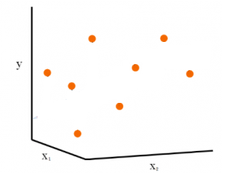
Here graphical represent of data of person age and it’s work experience which are independent variable and salary is dependent variable.
Out multiple linear algorithm will try to find plan that fit the best and minimum distance with all data points
Salary
age
Experience

Slide 3
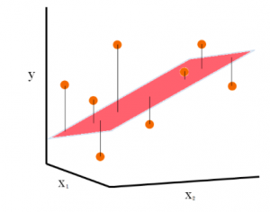
From this gram we can understand that our multiple linear regression algorithm plot a plan that have minimum distance wilt respect to all points.
Salary
age
Experience

